Slide 1
DBMS Mini Project
18CSC303J
Made by -
Tejas Chintala ( RA1811027010014 )
Vishrut Pundir ( RA1811027010029 )
Rohan Mathur ( RA1811027010048 )

Slide 2
Hospital Management
System

Slide 3
Abstract
Our project is aimed to act as a management system for both patients and doctors for managing their interactions. Patients & doctors both can see all the details that are required & add , delete & update it.
Hospital Management System project is a smart and effective way to store records of the patients tagged with their diseases & appointments with the doctors. The main target of this project is to target the patient information according to their details.

Slide 4
Tools Used For Front & Back End
Front End
Our front end is a simplistic UI which shows all the details of the Hospital management system. We created this simple system from scratch by designing the UI using HTML for structure and CSS for styling.
Back End
We are using MongoDB to connect to our backend database using python as our programming language.

Slide 5
Connectivity Steps & Procedure
The data input is being handled from the frontend & is being stored in the database. This database can be added, stored. updated, deleted & can also be searched based on keywords The keywords are -
Patients - Username , Password , Email ID
Doctors - Name , Email ID , Specialization , Phone number , Password
The web app also has a login system which can be used with the above keywords.

Slide 6
Demo Screenshots

Slide 7
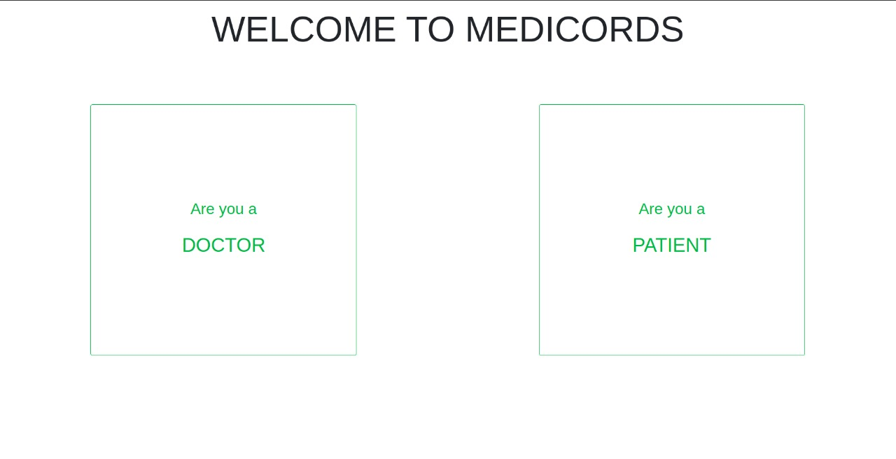
The First Page
User can select if they are Doctor or Patient

Slide 8
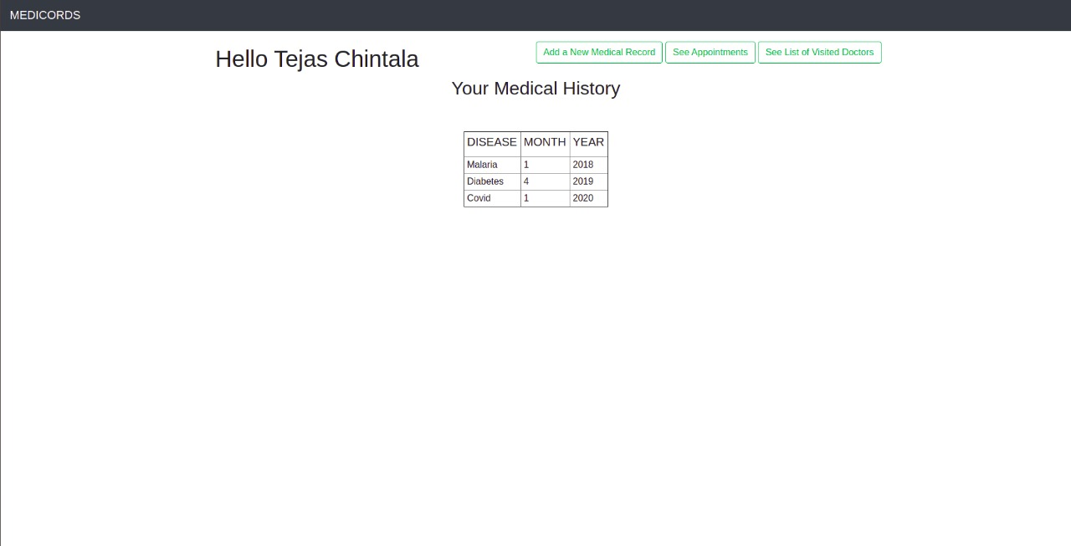
The Patient’s Page
The Patient can edit the following -
Medical Record
See List of Appointments with the Doctor
See List of Available Doctors

Slide 9
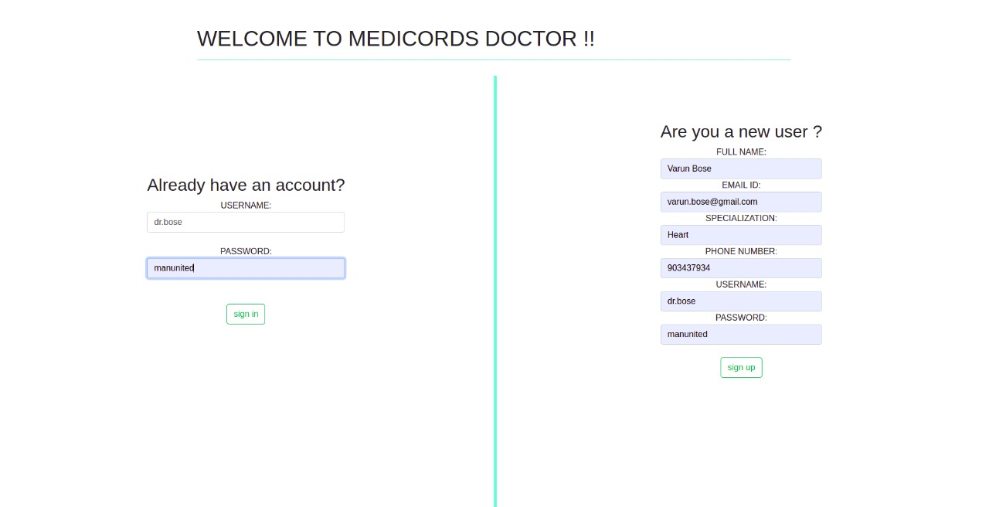
The Doctor’s Login Page
The Doctor can enter their necessary details to login - such as Specialization , Email ID etc.
Multiple Doctors can be added & selected for Appointments

Slide 10
Conclusion
The hospital management system has been implemented using the necessary tools.
Future Add ons
More details can be added such as Payment Status , Allotment of Room Numbers, Possible Home Remedies in Covid Times etc.
Connecting our frontend to a better, online hosted database using APIs to expand & increase our database size

